Slide 1
Matrix Methods for Linear Systems
廖顶超、周小龙、何秋香
20190401

Slide 2
本章主要从

Slide 3
Content
9.1 Introduction
9.2 Review 1: Linear Algebraic Equations(线性代数方程)
9.3
9.4
Apply??

Slide 4
Matrix Usage??

Slide 5
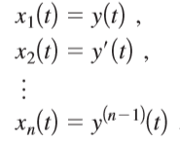
9.1 Introduction
In general, the customary way to write an nth-order linear homogeneous differential equation
as an equivalent system in normal form is to deﬁne the ﬁrst derivatives of y (including y, the zeroth derivative, itself) to be new unknowns:

Slide 6
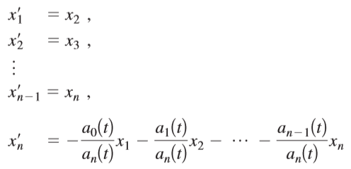
9.1 Introduction
Then the system consists of the identiﬁcation of as the derivative of together with the original differential equation expressed in these variables and divided by :

Slide 7
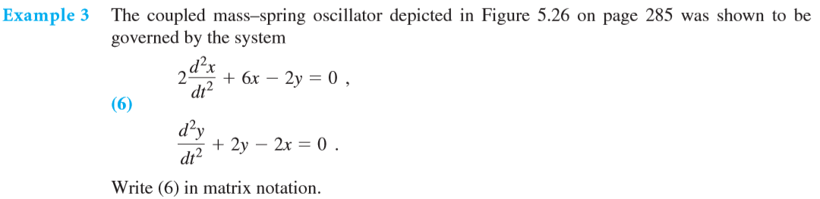
9.1 Introduction

Slide 8
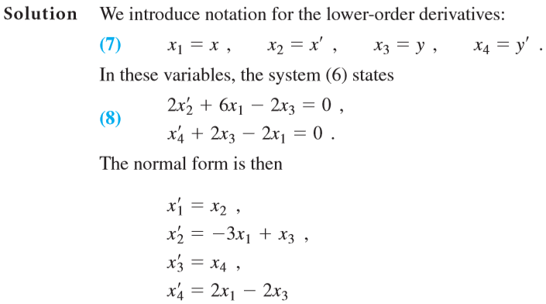
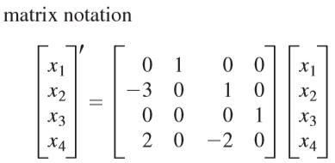
9.1 Introduction

Slide 9
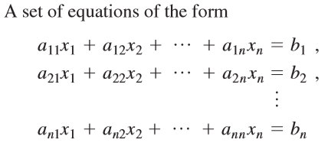
9.2 Review 1: Linear Algebraic Equations how to solve this ??

Slide 10
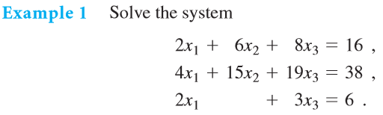
9.2 Review 1: Linear Algebraic Equations
Gauss–Jordan elimination algorithm

Slide 11
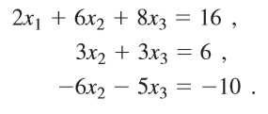
9.2 Review 1: Linear Algebraic Equations \
Gauss–Jordan elimination algorithm

Slide 12
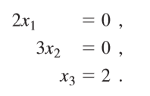
9.2 Review 1: Linear Algebraic Equations
Gauss–Jordan elimination algorithm

Slide 13

9.2 Review 1: Linear Algebraic Equations
Gauss–Jordan elimination algorithm

Slide 14







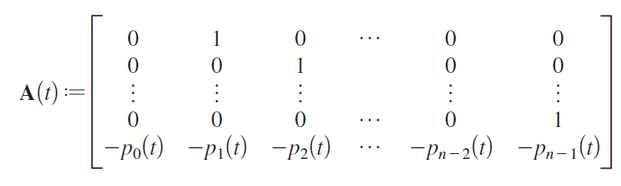
9.4 LINEAR SYSTEMS IN NORMAL FORM
Normal form

Slide 15
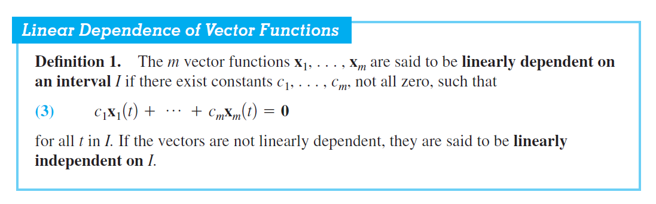
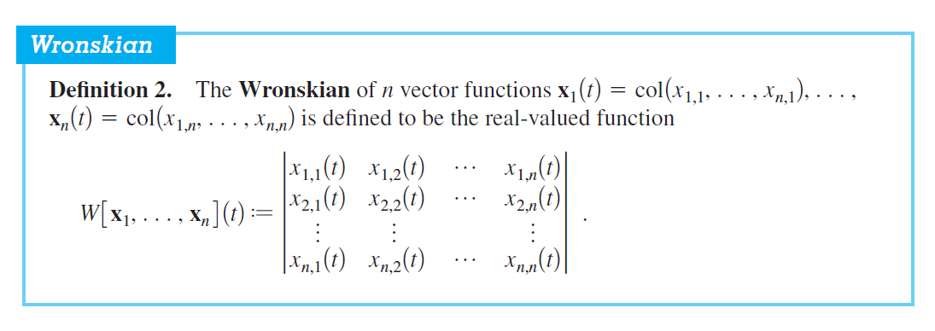
9.4 LINEAR SYSTEMS IN NORMAL FORM

Slide 16
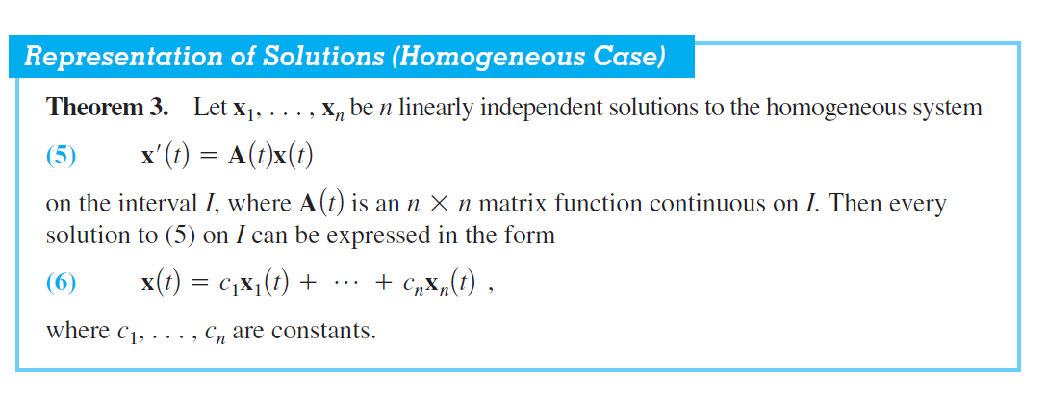
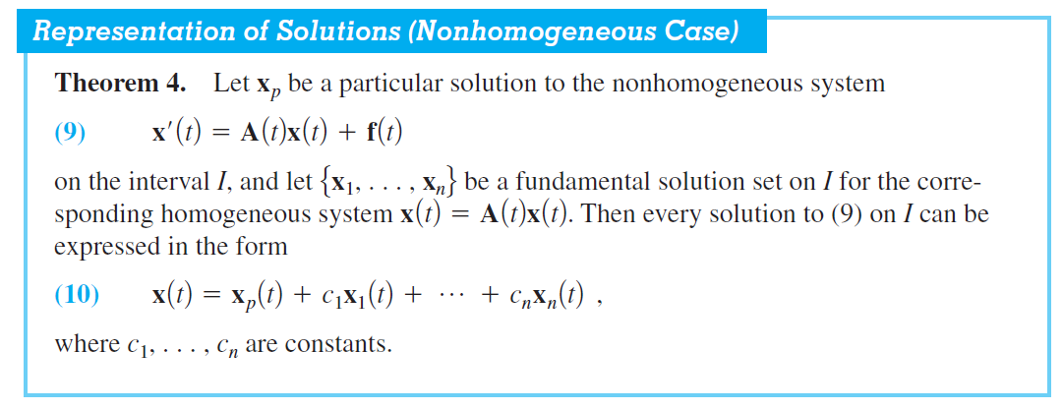
9.4 LINEAR SYSTEMS IN NORMAL FORM

Slide 17
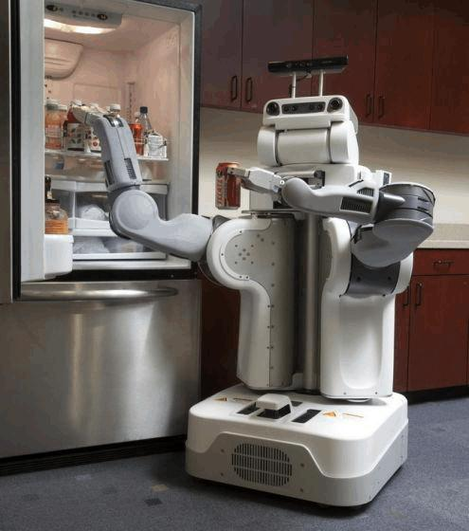
The use of a matrix in robotics
How does the robot locate a can of beer and complete the grabbing action?
How to represent the position and posture of a rigid body in robotics?

Slide 18
Position, Orientation and Frames
1.A set of position parameters that describes the full configuaration of the system.
Too many parameters
Show no relationship between the links
2. A location description and a orientation description to difine a link, from reference coordinate to end effectors.
Reduce the number of parameters
Make the system more closely connected
link
joint

Slide 19
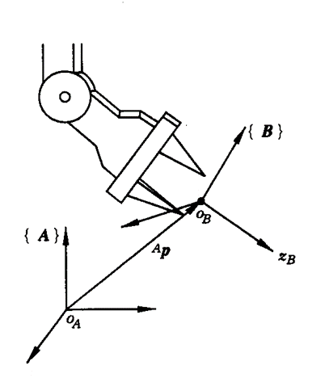

Position, Orientation and Frames in robotics
The use of a matrix
1.Position 2. Orientation
The vector ^{A}p represents the position vector of the arrow pointing to the point, where the upper right corner "A" indicates that the point is described by the frame {A} .
The frame {B} is attached to the end effector, and the orientatin of the tool can be described by the direction of the frame {B}. The direction of the frame {B} can be represented by a unit vector along three axes.
is actually the rotation matrix
from frame { A } to { B }
$${}_{B}^{A}R$$

Slide 20
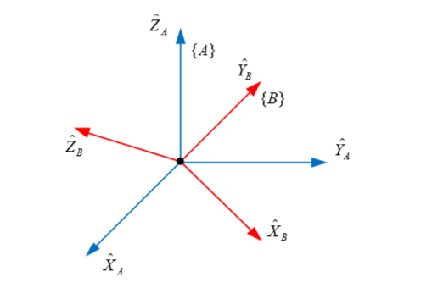
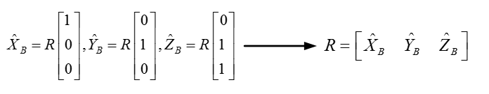


Rotation matrics
The use of a matrix
Orientation can be described by the rotation matrix
Original matix:
V_{A}={X_{A}，Y_{A}，Z_{A}}^{T}
X_{A}={1,0,0}^{T}，Y_{A}={0,1,0}^{T}，Z_{A}={0,0,1}^{T}
Rotation formula:
V_{B}= V_{A}
$${}_{B}^{A}R$$
$${}_{B}^{A}R$$

Slide 21
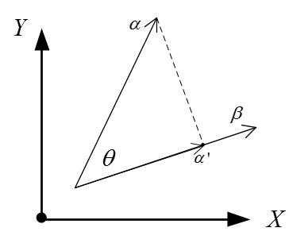
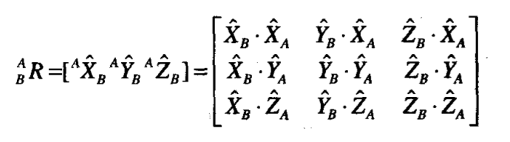
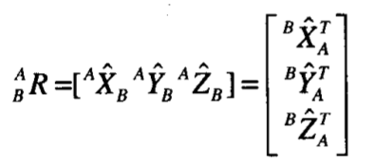
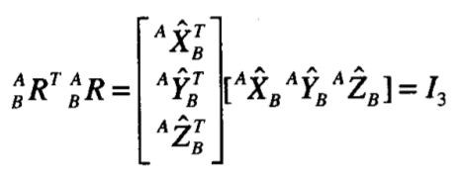
Mapping & TF between Frames
Orientation can be described by the rotation matrix
We can obtain the modulus of α·β equivalent to the modulus of β multiplied by α on β, so when |β|=1, α•β refers to the mode of α projected on β.
Dot product of vectors
The inverse of the rotation matrix is equal to its transpose

Slide 22

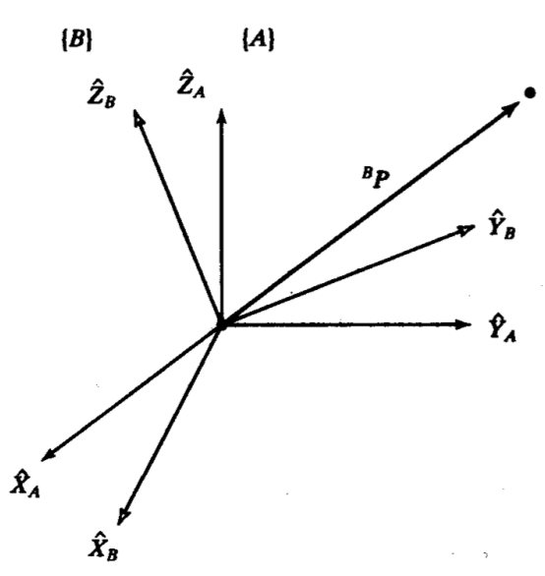
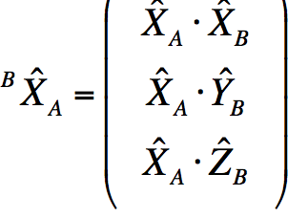
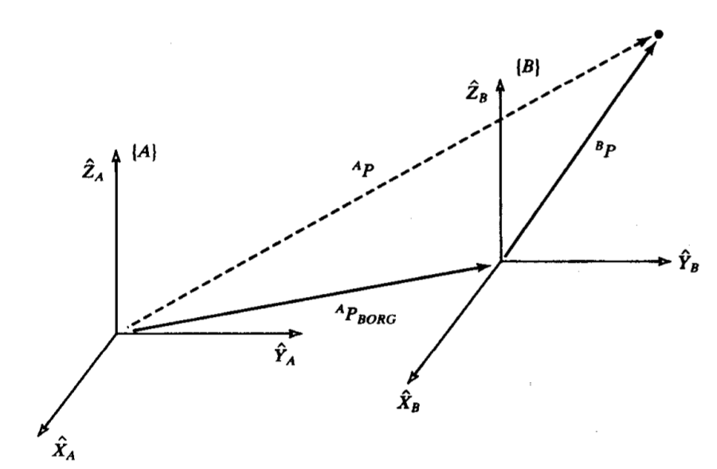
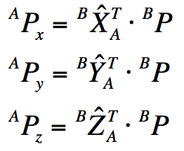


Mapping & TF between Frames
In robotics, position and orientation often appear in pairs, such as the frame {B} in the frame {A} is as follows
p
The position of P relative to {A} can be expressed as
Simplify the above formulas, we get

Slide 23
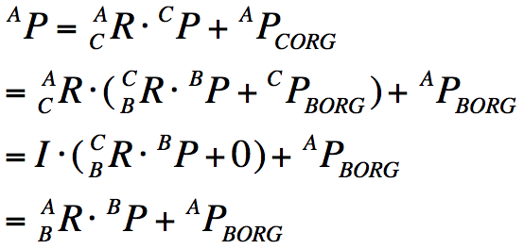
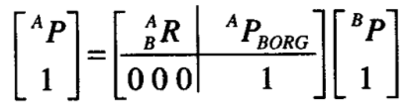
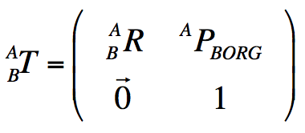
Mapping & TF between Frames
In a more general case, both rotation and translation exist simultaneously.
P
In order to more concisely express the above formula, we have
Homogeneous transformation matrix

Slide 24
THANKS

